Slide 1


Improving Reproducible Research with Shiny
Jordan Creed, MPH
Department of Cancer Epidemiology
Moffitt Cancer Center
Jordan.H.Creed@moffitt.org
jhcreed

Slide 2
Shiny : a package for developing interactive web based applications completely within R
Stable install
install.packages(“shiny”)
Development version
devtools::install_github(“rstudio/shiny”)

Slide 3
Structure
The pieces:
User Interface (UI) – designs the interactive components that the user sees
Server – action performed
Run statement – calls the UI and Server into action
Can be a single app file or separate UI and server files
library(“shiny”)
ui <- fluidPage(…)
server <- function(input,output){…}
shinyApp(ui=ui, server=server)

Slide 4
Layout
Fluid Page
ui <- fluidPage(
titlePanel(“R Workshop”),
sidebarLayout(
sidebarPanel(“Sidebar”),
mainPanel(“Main”)
)
)
ShinyDashboard
ui <- dashboardPage(
dashboardHeader(title=“R Workshop”),
dashboardSidebar(“Sidebar”),
dashboardBody(“Main)
)

Slide 5
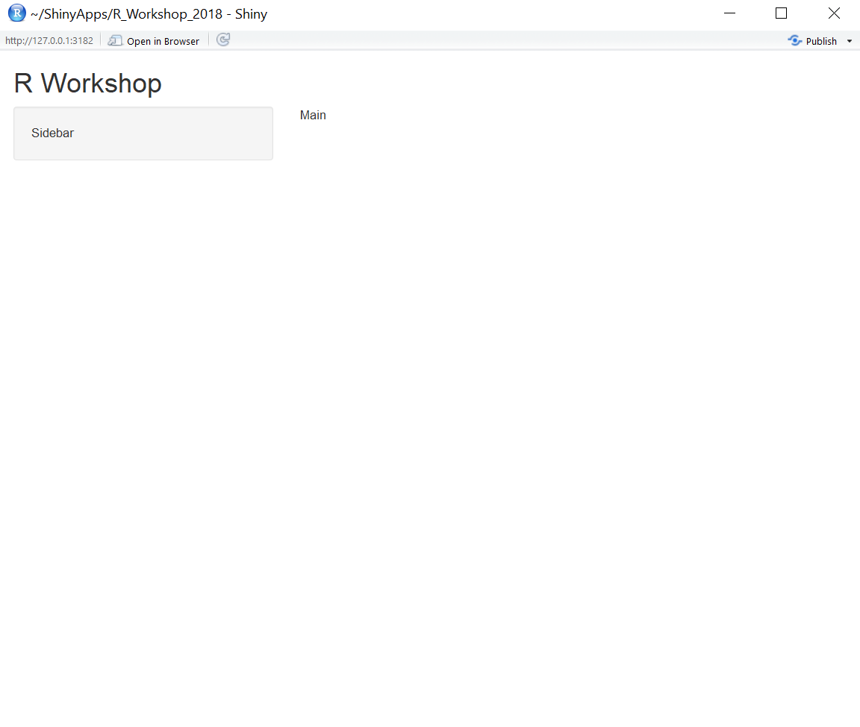
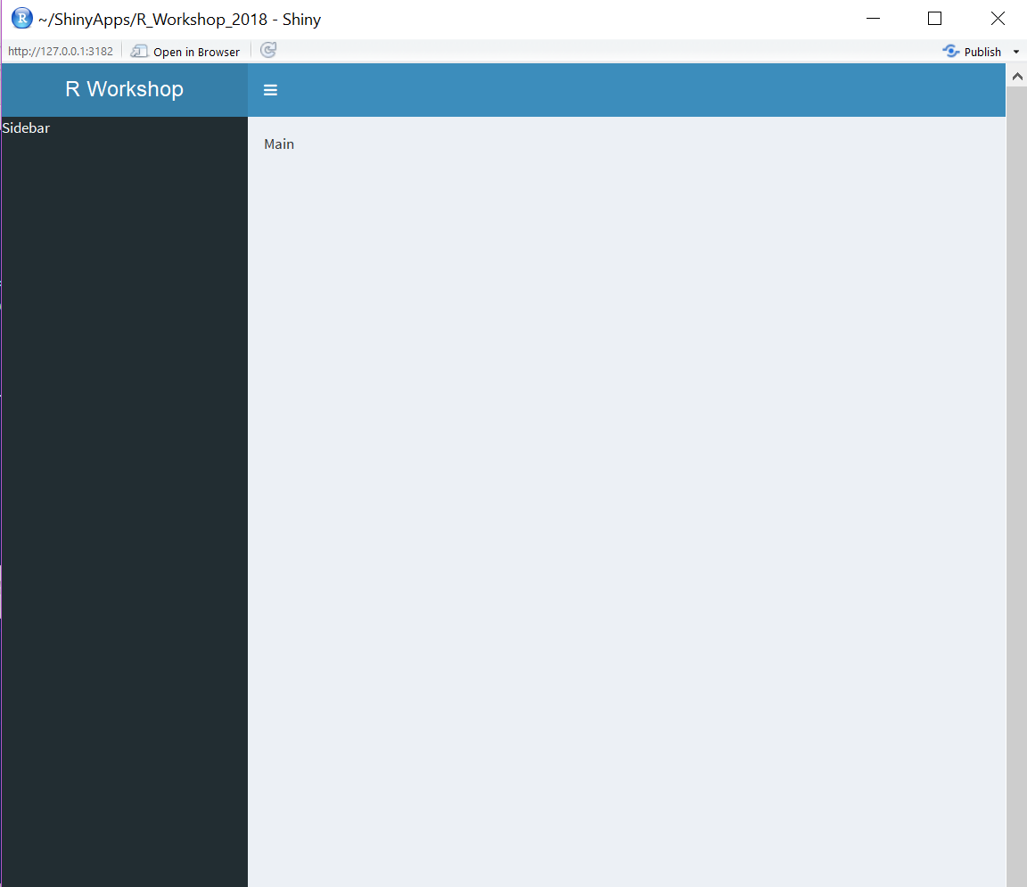
Fluid page vs shinyDashboard

Slide 6
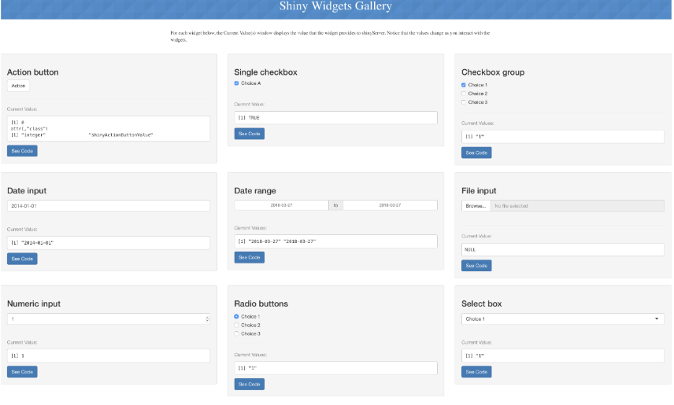
Widgets and Inputs

Slide 7
Basic Input Format
selectInput(“varY”, “Choose Y Variable”,
choices = list(‘Height’ = “height”,
‘Mass’ = “mass”,
‘Birth Year’ = “birth_year”)
)

Slide 8
Server Side
Output | Renders | Creates
htmlOutput |  | Raw HTML
imageOutput | renderImage | Image
plotOutput | renderPlot | Plot
tableOutput | renderTable | Table
uiOutput | renderUI | Raw HTML
verbatimTextOutput | renderText | text

Slide 9
Basic Output Format
output$scatter1 <- renderPlot({
plot(x = starwars$height,
y = starwars$height,
xlab = “Height”, ylab = “Mass”)
})

Slide 10
To R!

Slide 11
Sharing your Shiny App!
Hosting through ShinyApps IO
Build your own server to host
GitHub/ zip file
Shiny::runGitHub(‘shiny_example’ , ‘rstudio’)
runUrl(‘https://github.com/rstudio/shiny_example/archive/master.zip’)

